Slide 1
COSMIC Full Function Points (FFP)
How Do We Scientifically Measure Software Size?
Mohammad Alquamah Ansari
(Based on materials from COSMIC.org, ISO/IEC 19761, and academic case studies)

Slide 2
The Core Problem: The Absence of a Unit
Core Problem: The Absence of a Unit
The Challenge: How do we measure the "size" of a software system?
Legacy Flaws:
Lines of Code (LOC): Measures the solution, not the problem.
Staff-Months: Measures effort, not size.
The Consequence: Without a standard unit of size, software estimation and productivity analysis remain unscientific

Slide 3
The COSMIC Meta-Model & Core Principles
Definition: COSMIC Full Function Points (FFP) is a standardized method to quantify the amount of functionality a system provides to users.
The Principle: Measurement is based on functional user requirements and the interaction between a user and the software.
The Meta-Model's Components:
Triggering Event: Initiates a functional process.
Functional User: The human or external system.
Data Group: The set of data attributes that are moved.
Software Boundary: The conceptual line separating the system from its environment.

Slide 4
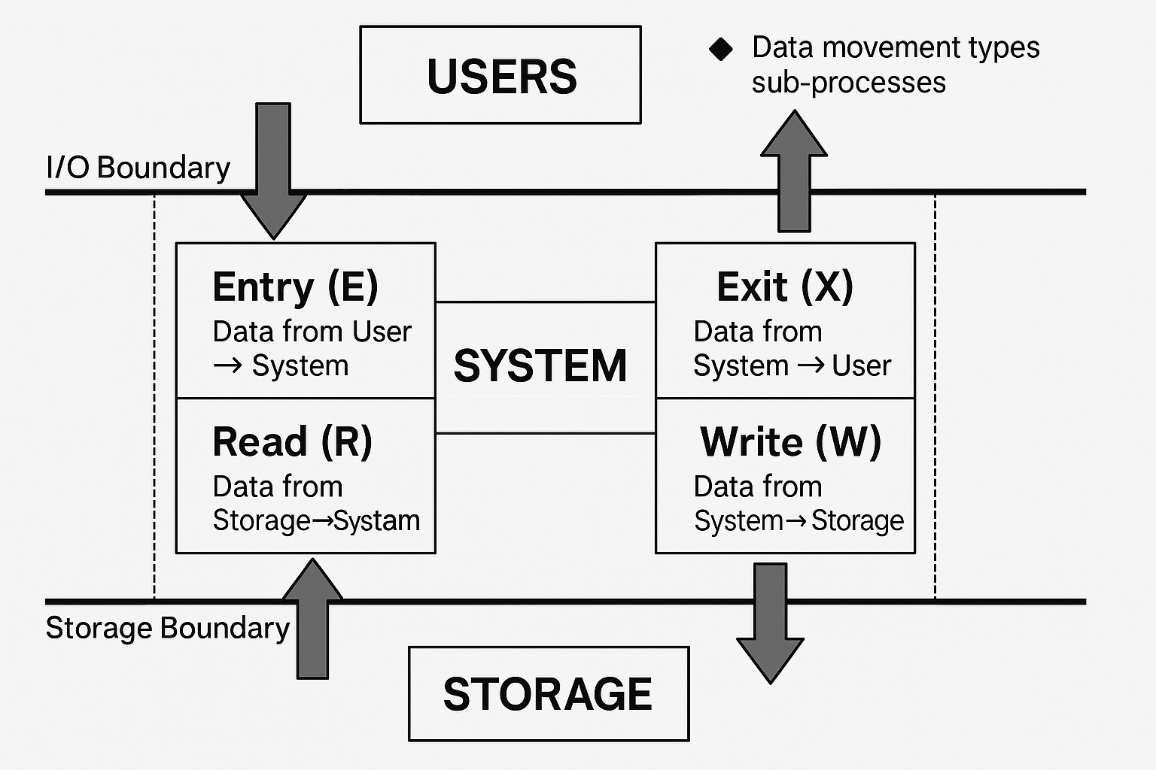
The Four Data Movements: The Quantum of Work
The Measurement Unit: The transfer of a single "data group" across a functional boundary.
Each movement contributes 1 CFP.
Entry (E): Data from User → System.
Exit (X): Data from System → User.
Read (R): Data from Storage → System.
Write (W): Data from System → Storage.

Slide 5
The Measurement Process: A Stepwise Formalism
Define the Scope: Identify the specific functional user requirements.
Identify Functional Processes: For each user event, identify a distinct process.
Identify Data Movements: Analyze each process to count its E, X, R, W movements.
Calculate Total FFP: Sum all the data movements.

Slide 6
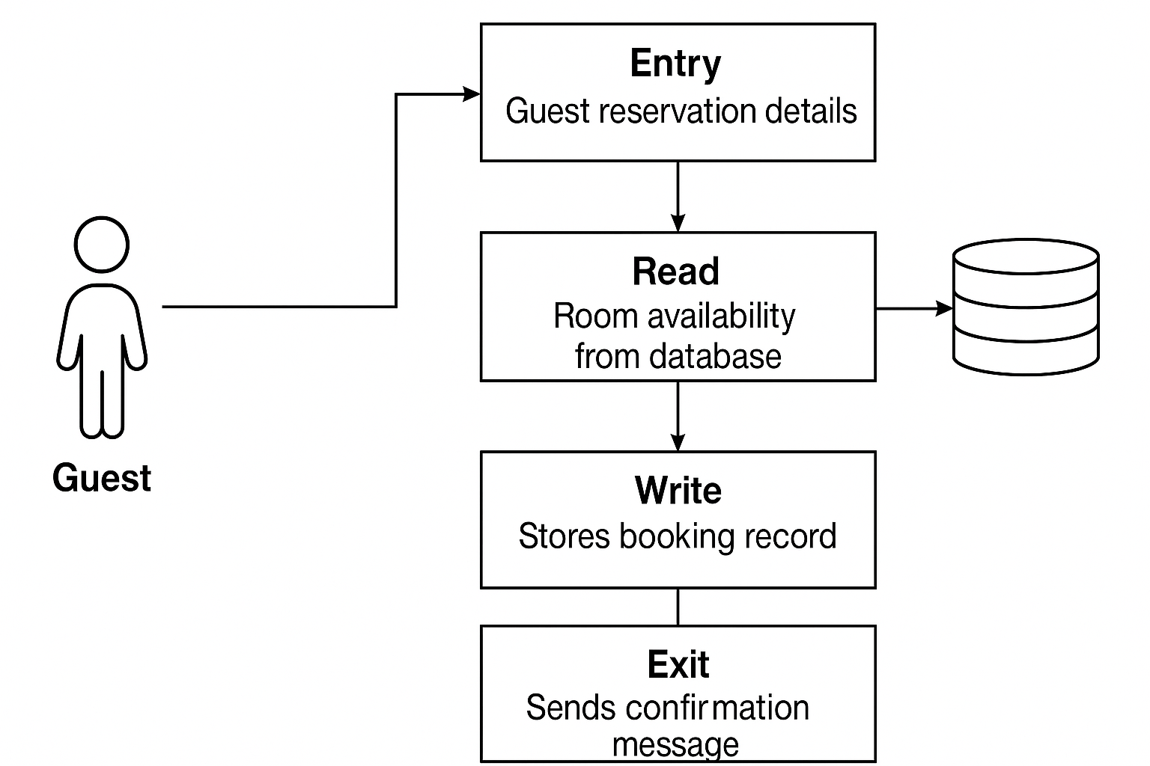
Case Study: Hotel Reservation System
Functional Process: Guest Booking
User: Guest
Breakdown:
1 Entry (Guest reservation details)
1 Read (Room availability from database)
1 Write (Stores booking record)
1 Exit (Sends confirmation message)
Total Size: 4 CFP

Slide 7
Advantages of COSMIC FFP
Technology-Independent: Does not rely on code lines or specific languages.
Applicable across Domains: Suitable for both business and embedded systems.
Supports Benchmarking: Enables objective comparisons across different systems or vendors.
Reliable for Outsourcing: Often used in contracts to measure and pay for functionality.

Slide 8
Disadvantages & Limitations
Steep Learning Curve: Requires training and experience to apply accurately.
Requires Detailed Specs: Cannot be used effectively if requirements are vague or incomplete.
Time-Consuming: Manually identifying and counting data movements can be effort-intensive.
Limited Automated Tools: Fewer commercial tools support COSMIC compared to traditional function points.

Slide 9
From Size to Effort: The Foundation of Estimation
The Core Equation: Effort = Productivity × Size
COSMIC's Role: Provides a reliable, objective "Size" variable (FFP).
The Result: COSMIC provides the essential input for a data-driven, scientific approach to project management.

Slide 10
Conclusion
Key Takeaways:
COSMIC FFP provides a formal, repeatable, and objective method for measuring functional size.
It is the foundational metric for data-driven project estimation.
While it has a learning curve, its benefits for benchmarking, estimation, and contract management are significant.

